Slide 1
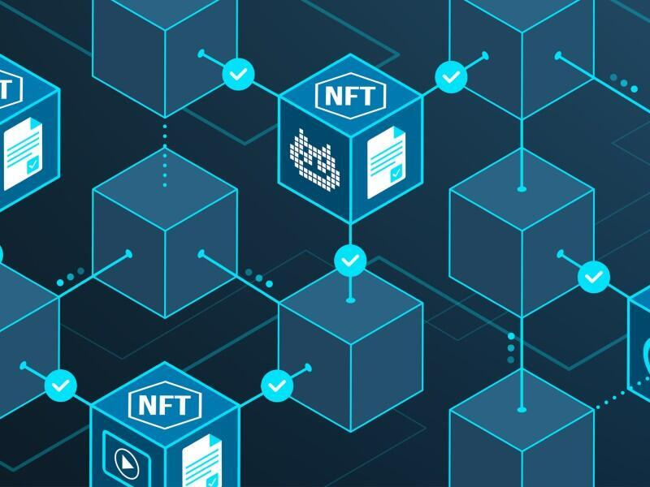
Blockchain Based NFT Platform
GUIDED BY:
Dr. D. Sumathi
TEAM:
AMIT KUMAR SAHU -18MIS7250
P.VARSHINI -18MIS7035
S.V.SURYA VAMSI -18MIS7211

Slide 2
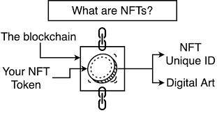
ABSTRACT
NFTS are non-fungible tokens.
Unique cryptographic tokens that exist on a blockchain and cannot be replicated.
Irreplaceable and provide exclusive ownership on the blockchain.
Can be anything digital, such as piece of art or drawings or music.
NFTS can represent real-world items like artwork.
“Tokenizing” this real world tangible assets makes buying, selling and trading them more efficient while reducing the probability of fraud.

Slide 3
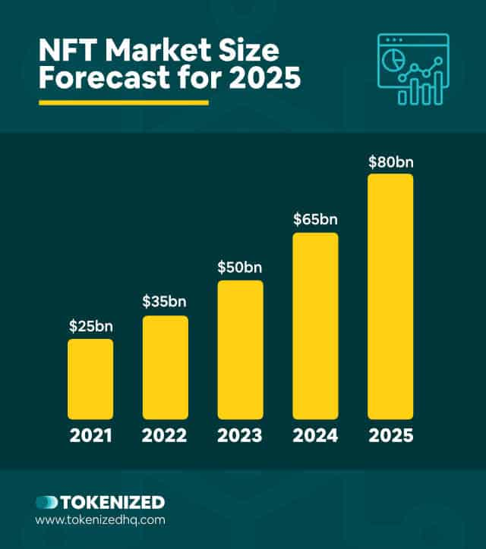
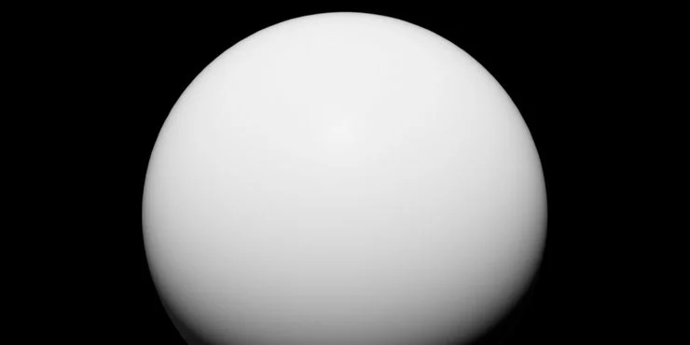
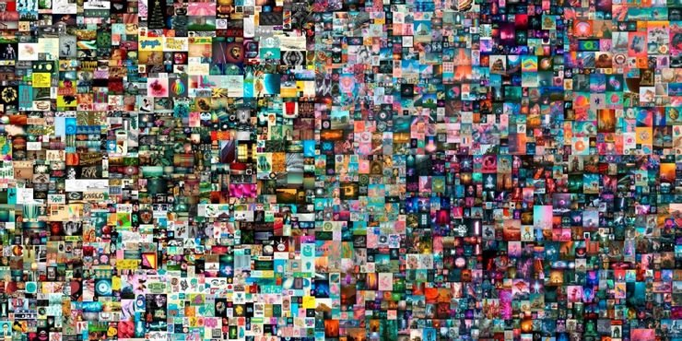
ANALYSIS OF NFT MARKETPLACE
In 2021-28.4 thousand and in this year over 22.6 thousand NFT’s were sold.
NFT transactions on popular marketplaces — most days in April and May of 2021 had between 1,000 and 3,000 unique wallets buying NFTs.
2.4 million NFTs sold on OpenSea, the largest NFT marketplace.
NFTs are becoming some of the most profitable blockchain-based experiments in history. High-profile influencers, like Twitter CEO Jack Dorsey, have recently made the news auctioning off NFTs.
Based on its current growth rate, reputable sources forecast the NFT market to grow to about $80 billion by 2025.
Total sales coming out to $91.8 million, it makes The Merge the most expensive NFT sale by a mile.
The First 5000 Days which is the 2nd most expensive NFT sold ($69 Million)

Slide 4
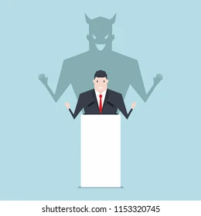
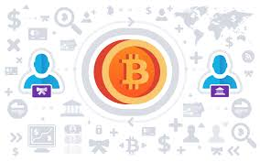

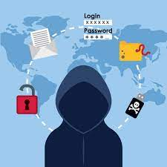
PROBLEM DEFINITON
Lack of existing platforms that would credit or give ownership to the real/genuine owner of the digital asset.
Either the digital assets are copied, or are sold in other platforms without authenticity or sense of ownership, which leads to duplicate assets.
Identity theft and hacking is also a major issue here.
Selling digital assets and later falsifying statement that, they didn’t bought/sold the digital asset.

Slide 5
MOTIVATION & OBJECTIVE
The main aim of the project is to build an open digital economy with a new type of digital goods called Non-fungible tokens and create a marketplace where we can sell and buy an digital art.
NFTs are unique cryptographic tokens that exist on a blockchain and cannot be replicated.
People are excited about a brand new type of digital goods called non-fungible tokens or NFTs.
It wouldn’t probably make a lot of sense to build an application where you’re trading in assets that are two to ten dollars on ethereum because the transaction itself costs more than that and transactions per second are slow but working on scalable solutions Like polygon transaction fee is lesser and faster.

Slide 6
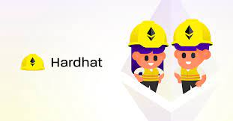
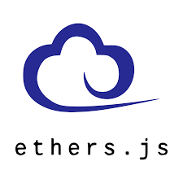
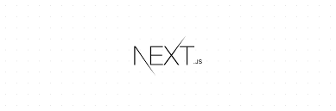
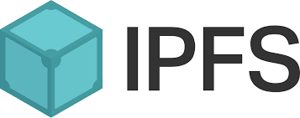
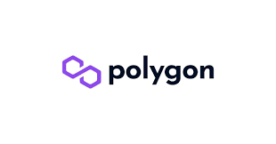
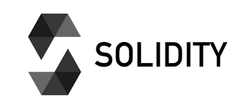
TECHNOLOGIES USED
Polygon Network (Blockchain Network)
Next.js (Backend framework)
HTML & CSS
Solidity (Blockhain based programming language)
IPFS (InterPlanetary File System)
Ethers.js (Interact with Ethereum blockchain)
Hardhat (Smart contracts simulation)
Google Chrome (METAMASK Plugin)

Slide 7
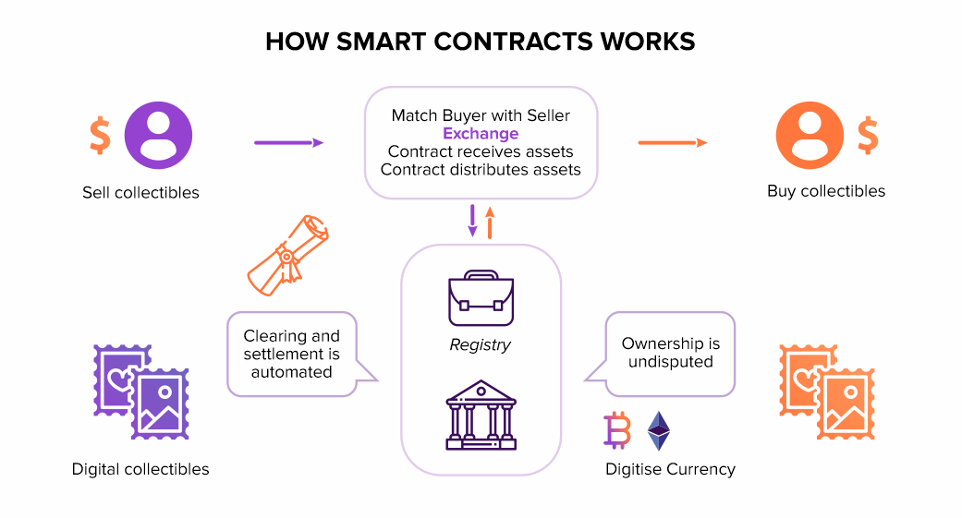

Slide 8
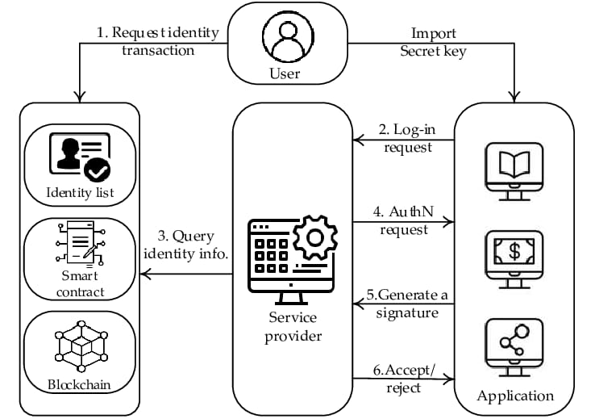
PROPOSED METHOD
A smart contract is a tool to implement a sale agreement between the NFT owner and the buyer, like a vending machine.
Smart contracts, being self-executing, are able to verify that the terms of the contract have been met and execute the terms without the need of an intermediary or central authority.

Slide 9
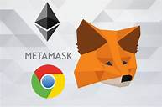
PROCESS FLOW
Create a NFT (a digital art piece).
Create a METAMASK wallet.
Login and authenticate to our application.
Select account and switch to local blockchain network.
List your NFT for sale in the platform.
Setting up metadata and price of item and list it for sale on the marketplace(upload and save files to IPFS).
After the user creates and lists an item, they are re-routed to the main page to view all of the items for sale.
Now the NFTs are ready to be sold and can be bought by people.

Slide 10
RESULT
Demo

Slide 11
Code Snippets
struct MarketItem {
uint itemId;
address nftContract;
uint256 tokenId;
address payable seller;
address payable owner;
uint256 price;
bool sold;
}
mapping(uint256 => MarketItem) private idToMarketItem;
event MarketItemCreated (
uint indexed itemId,
address indexed nftContract,
uint256 indexed tokenId,
address seller,
address owner,
uint256 price,
bool sold
);
/* Returns the listing price of the contract */
function getListingPrice() public view returns (uint256) {
return listingPrice;
}
// SPDX-License-Identifier: MIT OR Apache-2.0
pragma solidity ^0.8.3;
import "@openzeppelin/contracts/utils/Counters.sol";
import "@openzeppelin/contracts/security/ReentrancyGuard.sol";
import "@openzeppelin/contracts/token/ERC721/ERC721.sol";
import "hardhat/console.sol";
contract NFTMarket is ReentrancyGuard {
using Counters for Counters.Counter;
Counters.Counter private _itemIds;
Counters.Counter private _itemsSold;
address payable owner;
uint256 listingPrice = 0.025 ether;
constructor() {
owner = payable(msg.sender);
}

Slide 12
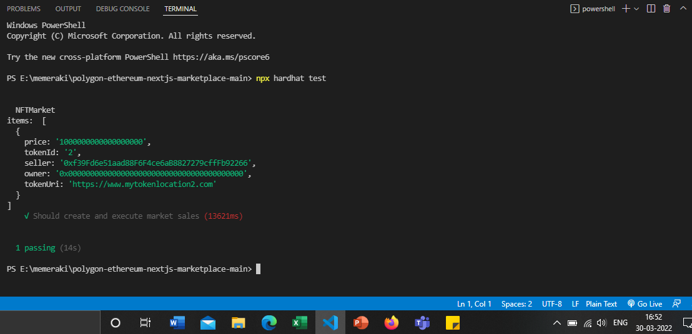
Testing Smart Contract for Marketplace

Slide 13
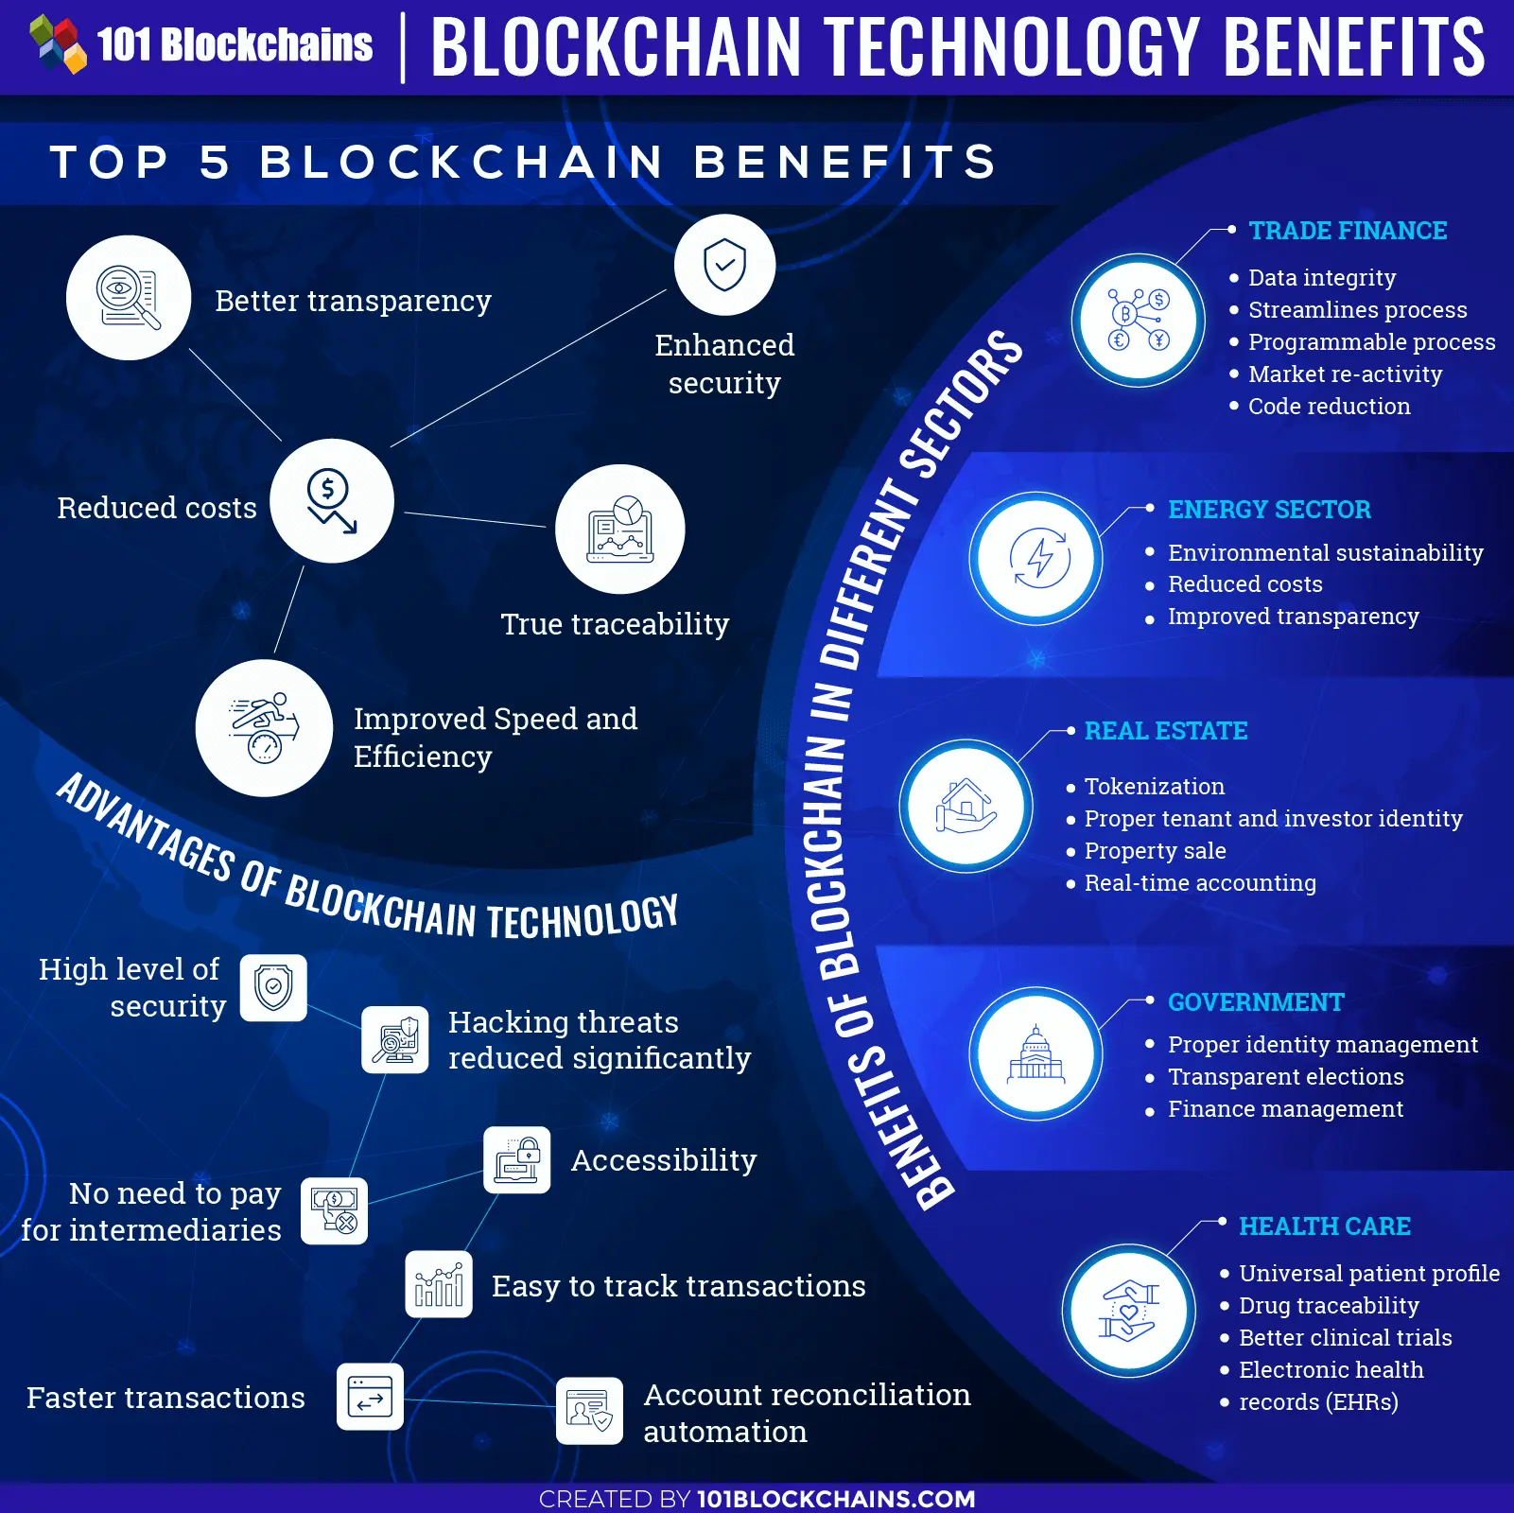
ADVANTAGES

Slide 14
REFERENCES
https://screenrant.com/expensive-nfts-sold-so-far/
https://opensea.io/
https://ethereum.org/en/nft/
https://ethereum.org/en/developers/docs/smart-contracts/
https://www.investopedia.com/web-20-web-30-5208698
https://polygon.technology/

Slide 15

